Slide 1
LabVIEW vs. Python
A detailed look at technical reasons why LabVIEW is a superior tool for large, complex test and measurement systems

Slide 2
DISCLAIMER
This is a draft. It is still being socialized among technical experts.

Slide 3
Goal and Agenda
This presentation provides a detailed assessment of the differences between Python and LabVIEW for an audience of test professionals.
Overview of Python and LabVIEW
Key considerations related to the design of scalable test software
Parallelism
Performance
Debugging
Ease-of-Use vs. Scalability
User Interface Development
Ecosystem

Slide 4
Executive Summary
Key points when evaluating the use of LabVIEW or Python
Both are very approachable tools that were built to empower people who don’t necessarily have a strong computer science background
As the industry-leading software for test professionals, LabVIEW has drivers for all major instrumentation vendors. Many drivers are also available for Python with various levels of support and run-time compatibility.
LabVIEW is compiled, which means it generates native assemblies for the intended target, whereas Python’s interpreter abstracts the instruction set of the execution platform and steps through every line of code at run-time. This makes LabVIEW inherently more performant.
Python can be compiled, but this will limit the range of libraries that can be used, as any use of reflection (aka: scripting), which is common in Python, makes compilation impossible.
The use of dynamic data-types in Python makes it very easy for new users, but it means that invalid types will cause run-time errors instead of being found during development. LabVIEW is strictly typed and has various tools in the editor to understand data-type coercions at edit time.
Python was designed to abstract low-level programming, but optimizing for performance and concurrency requires very advanced knowledge of computer science concepts, whereas the graphical nature of LabVIEW’s dataflow language makes it possible for the compiler to automatically identify performance optimizations and to enable concurrency without changes to the representation of application logic
Python benefits from a large ecosystem of users and developers across a breadth of industries and application areas, whereas LabVIEW’s ecosystem is very focused on the test and measurement domain
Python is free and open-source, whereas LabVIEW is paid software that is developed and maintained by NI (now owned by Emerson) but provides free version for students and hobbyists

Slide 5
Overview of Python
Python is one of the world’s most popular programming languages and is widely regarded as very easy to learn and use.
Key Things to Know:
Interpreted language: Unlike compiled languages, Python does not generate machine-specific assemblies. The code is executed line-by-line by the interpreter
Dynamically typed: This dynamic typing simplifies code writing but requires careful attention to avoid unexpected type-related issues.
Cross-platform: the Python interpreter abstracts the instruction set of a specific platform or OS
Large ecosystem of IP: PyPo hosts thousands of packages that are developed and maintained by the community, including NumPy, Pandas, Matplotlib, Requests, and Django
Open-source and free: this encourages adoption and empowers end-user to fork IP that is critical to their system
Object Oriented: Python programmers use classes to encapsulate and extend methods and the private data they act upon

Slide 6
Key Things to Know about LabVIEW
LabVIEW is a graphical development environment that has been built to empower domain experts to build sophisticated, large-scale test and measurement systems
Key Things to Know:
Compiled: LabVIEW’s is constantly compiling user code, which enables instant feedback throughout the development process. It uses a series of transforms to optimize and parallelize code before generating native assemblies for the intended target
Strictly typed: The structured dataflow syntax that LabVIEW uses is a natural way to express the flow of information through automation software and mitigates the occurrence of run-time issues as a result of dynamic data-types.
Cross-platform: LabVIEW’s graphical representation enables programmers to express application logic that can run on desktop operating systems, real-time operating systems and even Field-Programmable-Gate-Arrays (FPGAs)
IP for Test and Measurement: LabVIEW has an ecosystem of thousands of add-ons and open-source IP that is designed around the specific needs of test professionals
Free for Hobbyists and Students: LabVIEW Community Edition can be used for free by students and hobbyists
Object Oriented: LabVIEW programmers can use classes to improve the scalability and extensibility of their application, but it is not required

Slide 7
Considerations for Scalable Test Software
Parallel Automation is Common
Test systems typically need to coordinate execution of numerous, independent components, including multiple instruments, user-interfaces, loggers, network communications, safety monitoring, and more.
Performance is Critical
Maximizing throughput and operational efficiency requires reliable, performant software, which is increasingly difficult as test systems integrate multiple compute platforms like Windows, Linux RT and FPGAs. Compiling to the native assemblies of the execution target ensures the software is optimized, reliable and performant.
Debugging Requires Interacting with Engineering Data
Connecting to real-world signals adds complexity that often requires tweaking and iterating on software and analysis routines. As such, it’s common for low-level functions to benefit from dedicated user-interfaces
Must Have Support for Leading Instrumentation
Developers need the confidence that they will be able to quickly, easily and reliably connect to any class of instrument from any vendor using readily available drivers and communication interfaces.
Approachability Must Be Balanced with Scalability
Test engineers are typically domain-experts on measurement science; not software programming. To be productive, they need tools that make it easy to interact with hardware while ensuring that their software can grow to accommodate new requirements.
User Experiences Need to be Designed for Engineers
Developing tools to graph, measure, correlate and examine detailed engineering data should not be the job of a test engineer. Whenever possible, they should use standard, proven, performant tools to develop user interfaces, and they should expect that these will need to change and evolve as stakeholders express new ways in which they need to examine data.
Development Productivity Benefits from an Active Community
The ability to find and connect with peers who are not only using the same tool, but working in the same domain, is an important way to stay on top of technology trends, get access to the latest tools and productivity tips, and quickly resolve technical questions.

Slide 8
Parallel Automation is Common
The execution of test software is uniquely challenging due to interaction with external hardware, instrumentation, communication protocols, and more..
Key Requirements
Instrumentation for test software may span multiple device types and vendors, thereby requiring interaction with a variety of different drivers.
Drivers are subject to the performance and communication method of the hardware they are interfacing with
As a result, device drivers may have blocking calls and/or command schemes that are not easily synchronized across devices
It is critical that test software, and especially the user interface, remain responsive and independent of delays introduced by hardware, network connectivity, etc..
It is challenging to share data and commands across independent entities without introducing timing challenges that can lead to deadlock and/or race-conditions
Base
Controller
User Interface
Measurement
Results
Test Step Controller
Operator UI
Strain
Resistance
Diode I-V
Frequency Curve
Voltage
Figure 1: Test systems typically need to coordinate numerous software sub-components which ideally have centralized orchestration but also independent execution.

Slide 9
Parallel Automation is Common
The graphical syntax of LabVIEW enables parallel, independent threads without any change to the way code is written.
Image 1
Image 2
Image 3
Structured dataflow controls the flow of information through the program and functions require all inputs be populated before execution, thereby ensuring a deterministic execution flow.
Wire branches create independent copies of data, when necessary, which enables independent manipulation without worrying about execution order or references to shared data. Independent CPU threads are automatically spawned and managed by the compilers
Buffers are visually represented to enable communication between independent components of a system, enabling non-blocking communication for processes running at separate rates.

Slide 10
Performance is Critical
LabVIEW generates machine code specific and optimized to the execution target, whereas Python’s virtual environment provides a high-level abstraction that impacts performance and determinism.
Data-Flow Intermediate Representation (DFIR)
High-level graph-based representation
Preserves execution semantics, dataflow, parallelism, and structure hierarchy
Developed internally at NI
Low-Level Virtual Machine (LLVM)
Low-level sequential representation
Knowledge of target machine characteristics
3rd party, Open Source
Block Diagram
DFIR
Transforms
LLVM
Transforms
Target Machine Code

Slide 11
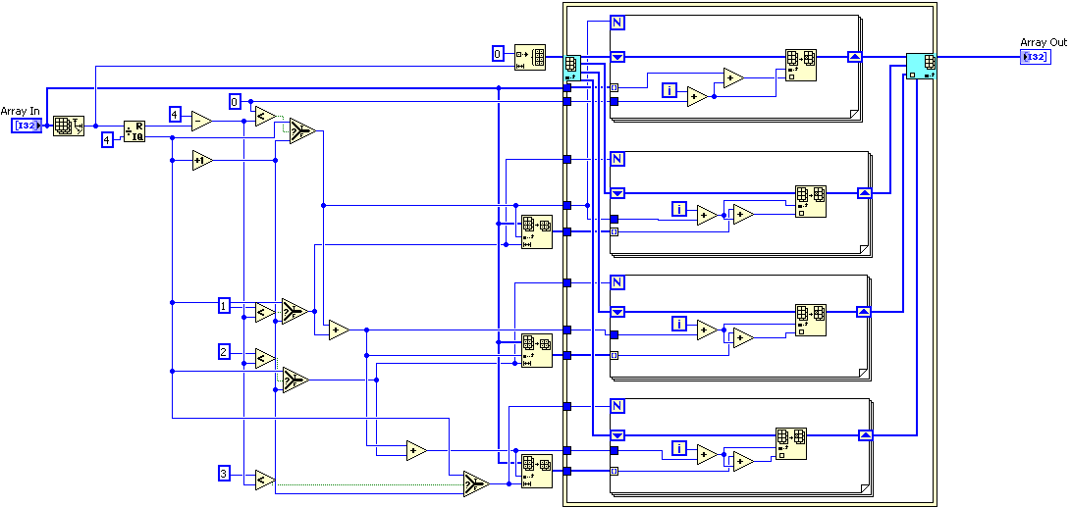

Elaboration of DFIR Optimization
NI’s DFIR technology enables automatic performance and memory improvements without any changes to the semantics of your application.
Examples:
Automatic in-lining of function calls to reduce overhead
Elimination of logically un-reachable code
Extraction of logic that is loop-invariant to single static call
Automatic parallelization of iterative processes
LabVIEW does have tools, such as the parallel for loop, to provide explicit control over concurrency and the number of threads, but this is not required or necessary for most LabVIEW programs.

Slide 12
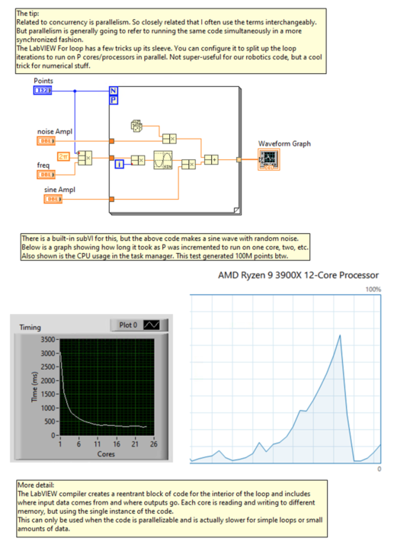
Example of Automatic Concurrency

Slide 13
Debugging Requires Interacting with Engineering Data
Every single function in LabVIEW has a user interface. The ability to quickly and readily see a data value at any point throughout the execution of your code enables rapid debugging, development and iteration on software
Image 1
Image 2
This example shows the execution of a function that is talking directly to hardware via the DAQmx API. The front panels of functions can be viewed during development and optionally deployed to the final test station.
This example shows…

Slide 14
Approachability Must be Balanced with Scalability
The ease-of-use encourages people with minimal software training to use both LabVIEW and Python. However, unlike LabVIEW, developing a large-scale Python system requires understanding how to explicitly manage threads, manage memory, develop Uis, etc.., whereas LabVIEW abstracts these complexities.
Performance: Python's interpreter inherently has slower execution times compared to compiled languages. This can be a significant drawback in systems where performance and low latency are critical.
Memory Usage: Python's memory consumption can be high because of the overhead of its high-level data structures. For applications where memory efficiency is crucial, such as mobile app development or in embedded devices with limited resources, Python is often not the optimal choice.
Concurrency: Due to the Global Interpreter Lock (GIL) in CPython, Python's native thread-based parallelism is not truly concurrent, which can be a limiting factor in CPU-bound applications needing to fully utilize multicore processors.
Type Safety: Python is dynamically typed, which means type errors are only caught at runtime. This can lead to bugs that are hard to detect in large codebases or critical applications. Languages like LabVIEW that are strictly typed ensure that these issues are found at compile time.
Scalability Concerns of Python

Slide 15
User Experiences Need to be Designed for Engineers
LabVIEW comes with an extensive library of controls and indicators that have been designed to serve the needs of the engineering and scientific community. It is otherwise very difficult and time consuming to develop or integrate these types of displays that can handle the volume and range of data-types that are common to test and measurement systems
.
UI Example
UI Example
UI Example

Slide 16
User Experiences Need to be Designed for Engineers
Additional UI Examples
.

Slide 17
Development Productivity Benefits from an Active Community
Anyone can put ‘Python’ on their resume, but how can you find an expert with the programming skills that also understand the application domain?
LabVIEW is the industry-standard software for test professionals and is used by every high-technology industry.
All leading instrumentation vendors provide driver support for LabVIEW
LabVIEW’s ecosystem of developers, systems integrators, consultants, and IP are all built for the specific needs of the test and measurement industry
NI and third-parties provide training on LabVIEW that is specific to test and measurement applications
Number of LabVIEW Consultants
Number of Certified LabVIEW
Size of the VIPM.IO Community
Size of the VIPM.IO Community

